Slide 1
WELCOME
TO

Slide 2
Homechoice

Slide 3
COMMS
SESSION

Slide 4
AUGUST 2020

Slide 5


ICT
COMMS
AUGUST 2020
HOST: ATISH BHANA

Slide 6


Slide 7


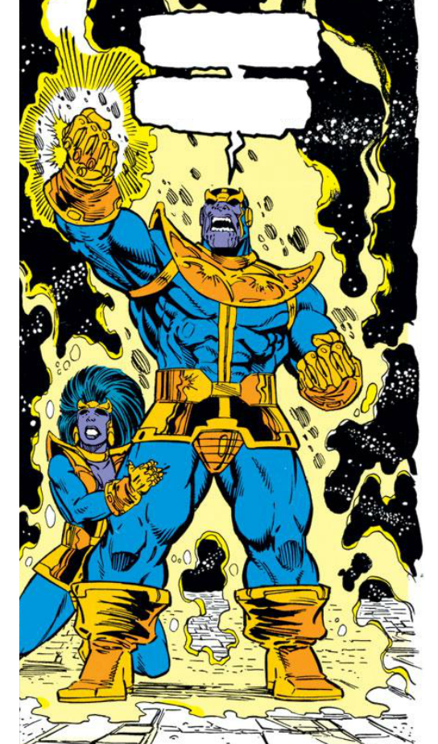








mANAGER’S uPDATE
I AM NEWB
TECH
NEWS
Project*Updates

Slide 8


NEWBS
Mmmm . . .
Fresh Meat!!

Slide 9

BIRTHDAYS
I was led to believe there would be cake!

Slide 10

AUGUST
2020
SEPTEMBER
2020
xxxx
xxx

Slide 11

Legends
Statistically speaking, he was always bound to make a come back.

Slide 12

No 1.
August 2020
SHANE
RETURNS

Slide 13



Uhh
CE
ADDRESS
Who watches the Homechoice?
HC RETAIL

Slide 14

PROJECT UPDATES
How much longer till December!?

Slide 15


D.E.V O.P.S (Deployment & enforcement virtualized On Production Systems)
Completed
xxxx
In Progress
xxx

Slide 16



C.r.e.d.i.t Team (creating real Errors destroying Info Technology)
ADP credit decisioning is live and stable –
More channels soon, until all channels are serviced by ADP
ADP enhancements / tech debt since go-live
AVS bank verification for Omega ready. CCWeb is in development
both scheduled to go live around mid-September
Pulling FC Naedo mandates into OptiCollect has stagnated on our side
waiting on FC
Mandatory Naedo in Omega has just gone live
Notes:
GERRIT CARINUS..

Slide 17

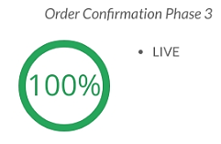
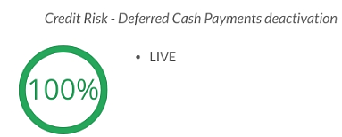

CCWEB TEAM – Recent Product Launches
Notes:
REINHARD to talk…

Slide 18

CCWEB TEAM – In Progress…

Slide 19

CCWEB TEAM – Coming Soon…
Credit Risk
xxx
xxx
Order confirmation
xxx
Product Push
Omni
channel
xxx
xxx

Slide 20
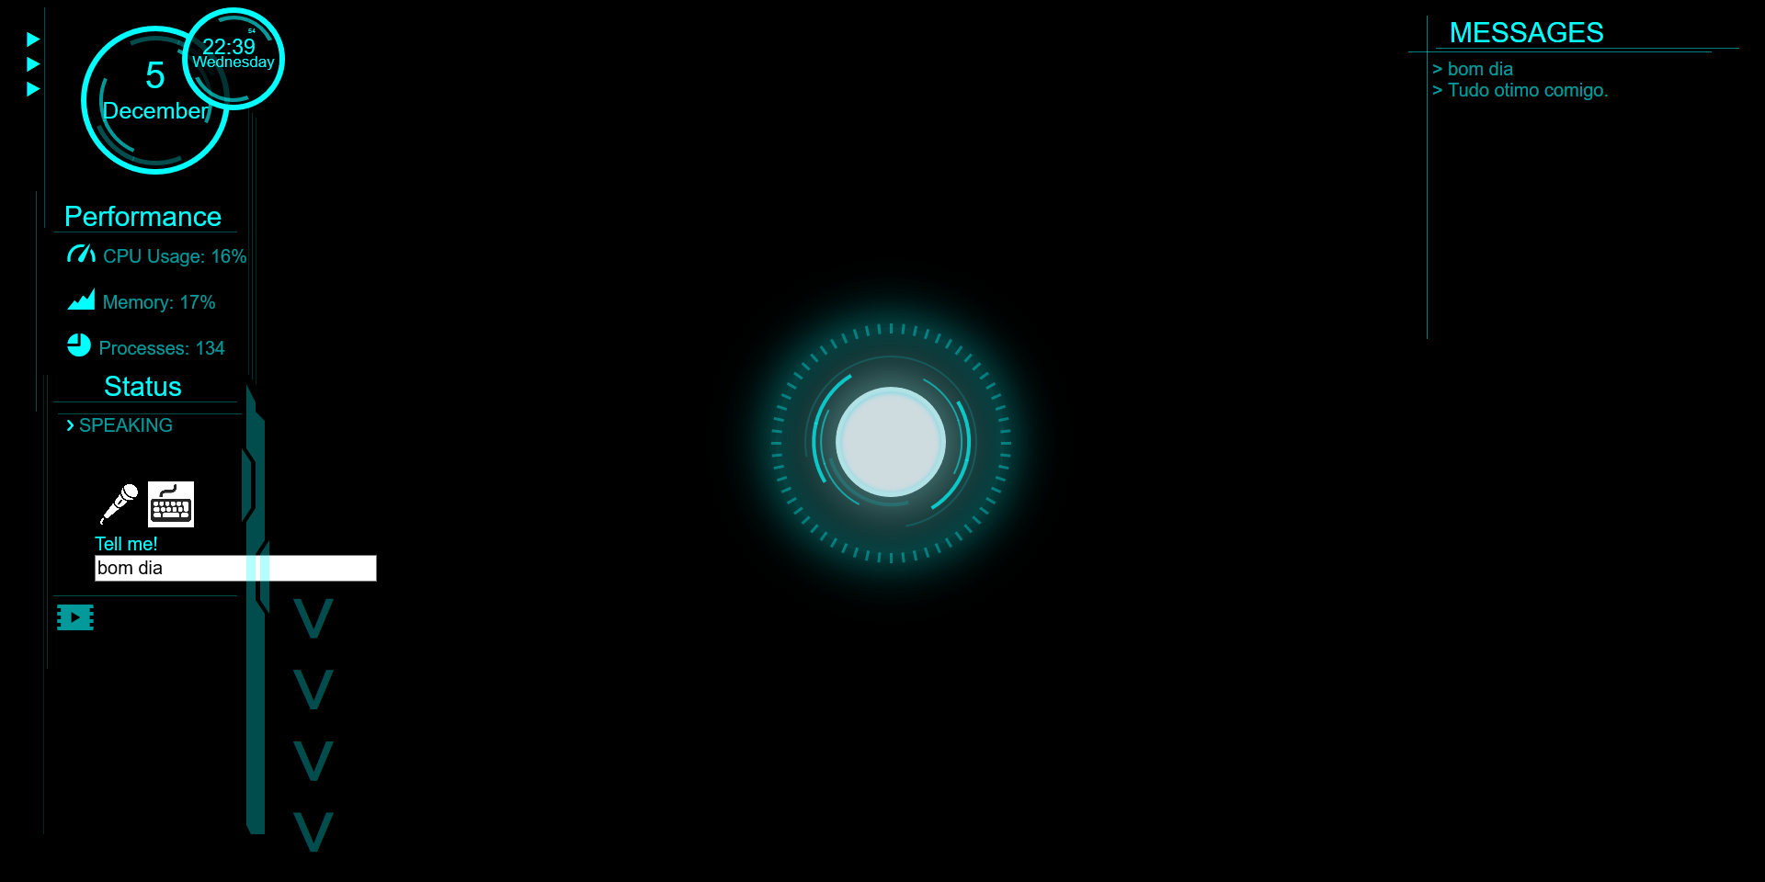
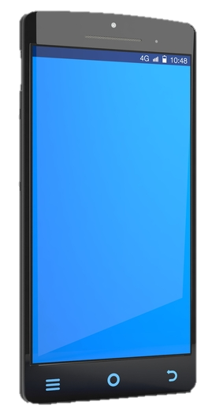
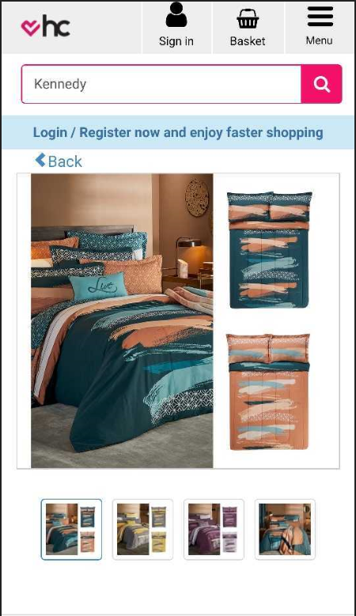


DIGITAL TEAM
zzz
xxxx
xx
xxx
xxx

Slide 21

DELIVERY TEAM
Track & Trace
xxx
xxx
xxx
Choice Collect
xxx
xxx
xxx
xxx
Collection point
Collection point
Our Office
Upcoming scheduled
xxx
xxx
Clearing (Post lock-down)
xxx
xxx
xxx
New report (Power bi)
xxx
Notes:
SIRAAJ will talk..
Delivery team:
Track and Trace:
On-boarding 2 additional courier partners:
Fastway couriers (assisting covering home delivery areas)
Courier IT (assisting more with Consumer electronics)
ChoiceCollect:
Added an additional 3 Containers as Collection points
Hammanskraal Container
Spruitview Container
Butterworth Container
Upcoming Showrooms scheduled:
Promenade - Mitchells plain Showroom
Katlehong Showroom
Clearing all undelivered (Post lock-down)
SAPO removed from HomeChoice network
Collection point parcels handed over to for home deliveries
ISP’s were turned off so that FNF could fulfill instead
New POD report created (Power bi)
To proactively assist business in highlighting delays with our courier partners

Slide 22



OptiCollect Team
Days of Future collections
I’m here to collect bub!
Completed
Tech Debt items
zzz
In Progress
xxx
xxx
xxx
xxx
LAZ
Notes:
JASON WILL TALK TO THIS..

Slide 23


TESTERS
Test Process
sss
aaa
By the end of this slide
Half of
them will be
DEAD
Test Automation
asd
asd
asd
asd
xcv

Slide 24


TECH NEWS
red outfit, White eyes ?
That’s copyright infringement
Pal !!!

Slide 25

Manager’s
Update
Keep It real
Play as a Team
Think like
entrepreneurs
Raise
the
bar
Keep Innovating
Wow Customers

Slide 26
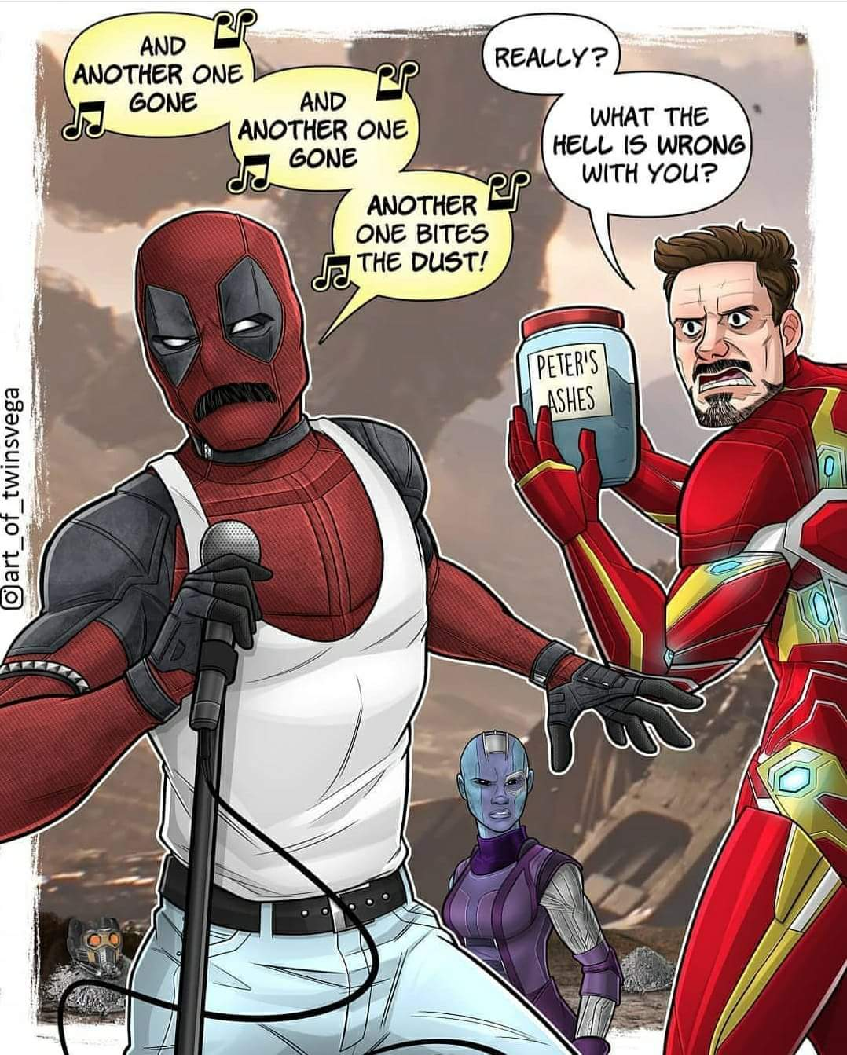

KARAOKE
Notes:
https://youtu.be/NrI-UBIB8Jk

